Slide 1
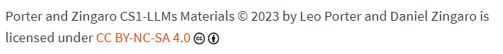
CSE 8A – Introduction to Programming and Computational Problem Solving I
Game Design – A Big Example
How to get help:
Class Website
https://sites.google.com/ucsd.edu/cse8afa23/home
Piazza for brief questions or logistic questions
Tutor Hours for help with homework/setting up computer To get help, use Autograder (directions on piazza)
Office Hours for homework/conceptual help
Slides based, in part, on materials from Dan Zingaro.
Notes:
Welcome!

Slide 2
Announcements
Grades Posted on canvas (including participation!)
Please review piazza post and check your grades
If correction needed, make a private post on piazza
Participation – make sure you are registered. Need to click in 80% to get credit
Quiz 4 – 12/6 (Week 10)
Code writing only. Guide released.
Will be more geared toward images (of the content you’ve seen)
Lab 8 tomorrow (debugging + images)
Last lab Project 2 – Images (hard deadline 11/27)
Project 3 on games!

Slide 3
Learning Goals for Today
By the end of today’s lecture, you should be able to:
Determine the design of a game including the appropriate data structures to represent the state of the game
Author a game in Python with a playable user
Author a game simulation in Python

Slide 4
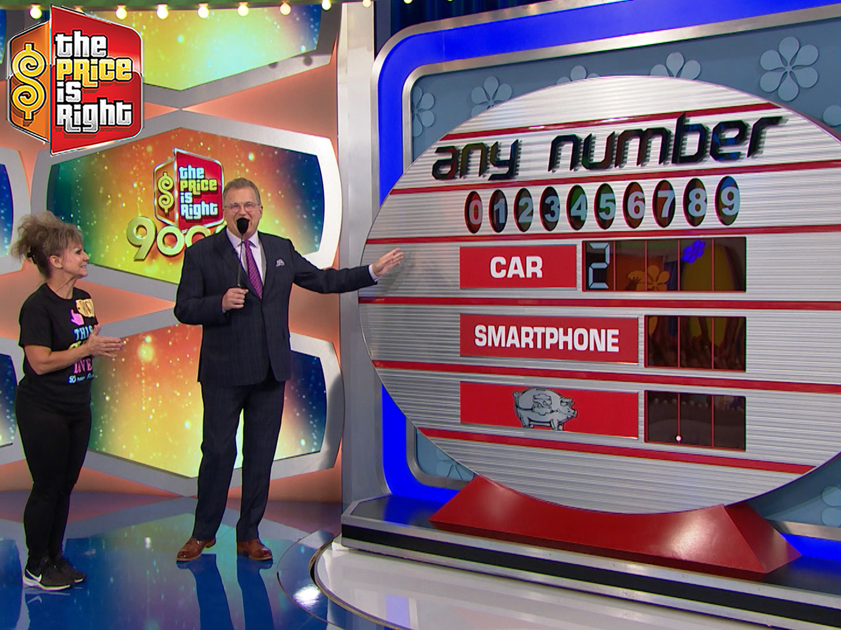
The Game – “Any Number”!
Rules:
Each digit appears once on the board (except the first digit in the big prize in modern episodes)
The player receives the first prize that has all the numbers completed
Any Number from the Price is Right: credit Amazon
Notes:
Original game on the Price is Right!

Slide 5
Our Big Picture Goal
Write the code to create two things:
A playable game by the player
A game we can simulate running repeatedly to determine the likelihood of winning
Notes:
List of lists – separate solution and current board
List of lists with tuples
Single list, we manage the math behind the scenes
Pretend there’s a solution and we create it as we go along. Possibly harder to debug.
Dictionary idea from Dan
Check for duplicate guesses or silent fail?

Slide 6
Let’s Play!
Car | 2
Appliance
Bank
Notes:
Solution:
29,640
832
715

Slide 7
Let’s Break that down….
Car | 2
Appliance
Bank
Game Setup
Notes:
I had a solution already made. The solution had unique numbers in it and I’d chosen the first digit in the car.
- We’ll need to pick a first digit for the car
- We need to create a solution that has each digit occur exactly once.
29,640
832
715

Slide 8
Let’s Break that down….
Car | 2
Appliance
Bank
Game Play
Notes:
Guessed a number, I checked to see where it occurred in the solution, and filled in the number
After each guess, we have to check if the game is over – is the number already included in the solution

Slide 9
Key Decision – How to represent the board!
Talk with your groups for 2-3 minutes, what data structure(s) should we use to represent the solution and the board.
Notes:
Let them come up with answers
List of lists – separate solution and current board
List of lists with tuples
Single list, we manage the math behind the scenes
Pretend there’s a solution and we create it as we go along. Possibly harder to debug.
Dictionary idea from Dan
Check for duplicate guesses or silent fail?

Slide 10
Key Decision – How to represent the board!
Solution
List of Lists with numbers for the solution and the board
2 | 1 | 2 | 3 | 4
5 | 6 | 7
8 | 9 | 0
Board
2 |  |  |  | 4
 | 6
8
Notes:
A first idea might be to do this. The only challenge might be how to represent empty spots on the board. We could use “_” but that’s confusing types.

Slide 11
Key Decision – How to represent the board!
Solution
List of Lists with numbers for the solution and Booleans for the board
2 | 1 | 2 | 3 | 4
5 | 6 | 7
8 | 9 | 0
Board
T | F | F | F | T
F | T | F
T | F | F
Notes:
An alternative might be to just represent the board as Ts and Fs for what values are known from the main solution.

Slide 12
Key Decision – How to represent the board!
Board and Solution
List of Lists with tuples for both board and solution
(2,T) | (1,F) | (2,F) | (3,F) | (4,T)
(5,F) | (6,T) | (7,F)
(8,T) | (9,F) | (0,F)
Notes:
An alternative might be to just represent the board as Ts and Fs for what values are known from the main solution.

Slide 13
Key Decision – How to represent the board!
Single List for each and we handle the math behind the scenes
Solution
2 | 1 | 2 | 3 | 4 | 5 | 6 | 7 | 8 | 9 | 0
Board
2 |  |  |  | 4 |  | 6 |  | 8
Notes:
We could just know that indexes 0-4 are car, 5-7 are appliance, 8-10 are the bank

Slide 14
Key Decision – How to represent the board!
We pretend there’s a solution, but we just maintain a board. At each guess, we just randomly place the guess on the board.
Board
Do we like this idea?
Yes, it would work well.
Yes, but it might seem unfair
No, it’s not fair to the player
No, it may be harder to test
No, it’s harder to maintain the board
2 |  |  |  | 4
 | 6
8
Notes:
No right answer here – this is about them thinking about tradeoffs.
Random before vs. random during is the same in terms of “fairness”. But, as a human, it might seem disingenuous. Also, this isn’t great if you ever want to fill in with _real_ prices from a dataset or something.
Yeah, this is possibly true. Without a “solution” it might make it harder for us to compare the game behavior against what it’s supposed to do.
Probably easier to maintain the board, but a bit of a pain when we have to display the solution at the end. We’d need to fill in all the missing spots with random values at game end.
I would have considered this solution.

Slide 15
Aside – Can humans catch a cheating computer?
Colleague made a rock-paper-scissors game
The computer cheated. It always knew the human decision before it made its decision
Computer used delay in eye processing to make it seem like the computer responded before/at the same time as the human
Goal was to see how much it could cheat before the human caught on
Notes:
The experiment was dropped, I believe, but I always thought it was a cool experiment.
Even paper rock scissors could be a fun game if you think through how to design a predictor of what the human is going to do based on past history. Random is optimal, but humans are bad at being random.

Slide 16
Key Decision – How to represent the board!
Solution could be a dictionary and the board is the numbers
Solution
Key | Value
0 | [(2,2)]
1 | [(0,1)]
2 | [(0,0),(0,2)]
3 | [(0,3)]
4 | [(0,5)]
5 | [(1,0)]
6 | [(1,1)]
7 | [(1,2)]
8 | [(2,0)]
9 | [(2,1)]
Board
2 |  |  |  | 4
 | 6
8
Notes:
Faster find for a number, but slow to reconstruct the board at the end. If this were a big, big board, then a dictionary might be warranted, but searching the entire solution every time isn’t that expensive with 11 numbers.

Slide 17
Which representation would you choose?
List of lists of numbers for both board and solution
List of lists of numbers for board and Booleans for solution
List of lists of tuples
List of numbers for both board and solution, handle math behind the scenes
Dictionary for solution, list of lists of numbers for the board
Notes:
These are ALL viable. A and B were both at the top of my list. C is tempting, but I think I like the logical separation of a board vs. a solution. D is too easy to get wrong. E. is clever, but feels like a bit of overengineering to me when the cost of search of an 11 entry board isn’t that expensive. With A, we need to figure out what to do with the missing numbers, but lists can be heterogenous, so we can just put a space there and be fine.

Slide 18
Factors to consider when picking a representation
Ability to accurately represent the game world
Ease of software design
Too complicated? Too clever?
Old adage: The person debugging code must be 2x more clever than cleverness used when writing the code
Limit potential to make mistakes
For this class (and usually at companies), this is more important than efficiency
Ease of testing
You should be able to test every function in isolation, be careful of too many dependencies between functions
Efficiency of design
Do you have to search a large dataset frequently?
(Really this is a focus of later classes)
Notes:
Talk these through.

Slide 19
Game Setup
What do we need to do?
Notes:
Have them give us the idea. Create a solution that adheres to the rules. Then create a board with just the first digit of the solution filled in. We’ll need to have a board and solution available to us at various points in time, so we need to figure out what to do with them. Should they be globals or objects passed around between functions?
This is a rare case I’d be tempted to keep them as globals, but we’ll go with passing them around. When you learn about classes, these would be instance variables but that’s for another course.

Slide 20
Concept Check for Tuples
Can we return a solution and board in a tuple… What does this code do?
one = [1,2,3]
two = [2,3,4]
tup = (one,two)
tup[0][1] = 5
print(one)
What is printed by this code above?
Prints [1,2,3]
Prints [1,5,3]
Error, tuples are immutable
Notes:
Draw a memory model – point out that tup[0] is immutable, but tup[0] gives you a list and the list is mutable. Common confusion.

Slide 21
Game Setup
Function Decomposition
Notes:
This should be easy. Main -> game_setup (returns tuple of the (board,solution), no params)
game_setup->solution_setup(returns list of list of numbers, no params)
game_setup -> board_setup (returns list of list, entries are either numbers or underscores,

Slide 22
What function is going to be harder to write?
game_setup()
solution_setup()
board_setup()
Notes:
Mainly for discussion!
Game setup and board setup are pretty easy, but we might guess solution_setup is going to be difficult because of our stipulations on the data

Slide 23
solution_setup
def solution_setup():
""" Create a list of lists to be returned. The first list
will contain 5 numbers, the second list will contain 3 numbers,
and the last list will contain 3 numbers. The first element of
the first list should be a number between 2-4 randomly. The
remaining 10 digits (the last 4 digits in the first list
and the 3 digits in the 2nd and 3rd list) should be unique random
numbers between 0-9.
"""
Copilot’s response:
return None
Notes:
Copilot first response is terrible. I tried messing around with the prompt and it didn’t do well. I think my last sentence was too vague….

Slide 24
solution_setup – some other options
def solution_setup():
""" Create a list of lists to be returned. The first list
will contain 5 numbers, the second list will contain 3 numbers,
and the last list will contain 3 numbers. The first element of
the first list should be a number between 2-4 randomly. The
remaining 10 digits (the last 4 digits in the first list
and the 3 digits in the 2nd and 3rd list) should be unique random
numbers between 0-9.
"""
# Your code here
return [None, None, None]
return [[],[],[]]
return [[3, 1, 9, 5, 7], [2, 6, 0], [8, 4, 7]]
Notes:
First is obviously wrong, second is too. Third isn’t right either! The only duplicate allowed is with the first number. But 7 is a duplicate.

Slide 25
solution_setup – A possible option?
What is wrong with this code?
Runs forever
Doesn’t set the first digit to a number between 2-4
Doesn’t ensure the 10 numbers are all unique
Doesn’t make a list of the right size (3 lists, first with 5 elements, next two with 3 elements)
Nothing, this is correct
first_list = [random.randint(2,4)]
second_list = []
third_list = []
for i in range(10):
if i < 4:
first_list.append(random.randint(0,9))
elif i < 7:
second_list.append(random.randint(0,9))
else:
third_list.append(random.randint(0,9))
return [first_list, second_list, third_list]
Notes:
No attempt to ensure all 10 numbers are unique, just plain wrong.

Slide 26
Summary
When designing games, you need to have your code maintain the state of the game in data structure(s). Picking these data structures is crucial to a good programming experience.
Copilot did well for our easier functions, but our specialized function for creating the solution was hard for it without human intervention.

